Slide 1
Understand std::vector
Huỳnh Ngọc Thi
so61pi.re@gmail.com

Slide 2
Why?
std::vector is a fundamental data structure in C++.
It’s used everywhere.
It’s array-based, good for performance.
Maybe not the best, but still.
Its iterator’s category is RandomAccessIterator, which is required by some algorithms
shuffle, sort, stable_sort, nth_element, make_heap, sort_heap, …

Slide 3
Placement new
How can we construct std::string on a given buffer?
Placement new
T* = new (buffer) T;
char buffer[sizeof(string)] = {};
auto pstr = new (buffer) string{"abc"};
How can we destruct it?
Placement delete?
We must call destructor ourselves.
pstr->~string();
https://isocpp.org/wiki/faq/dtors#placement-new

Slide 4
std::vector memory layout
Why do we have extra “unused” space?
push_back/emplace_back can have amortized constant complexity.
Amortized constant complexity
“The basic idea is that a worst case operation can alter the state in such a way that the worst case cannot occur again for a long time, thus “amortizing” its cost.”
https://en.wikipedia.org/wiki/Amortized_analysis

Slide 5
std::vector memory layout
Basically, std::vector is constructed from 3 pointers.
first
last
end_of_space

Slide 6
push_back complexity analysis
If we don’t have that “unused” space
Each push_back
allocate new memory
move/copy old elements
construct new element
destruct old elements
free old memory.
O(n)

Slide 7
push_back complexity analysis
Else,
New element can be constructed without reallocating memory.
We have a growth factor, k.
Each time reallocation happens, new size = max(size() + 1, size() * k).
MSVC uses 1.5 (_Grow_to), libstdc++ 2 (_M_check_len).

Slide 8
push_back complexity analysis
k = 2
before push_back |  | after push_back |  | reallocation
size() | capacity() | size() | capacity()
0 | 0 | 1 | 1 | true
1 | 1 | 2 | 2 | true
2 | 2 | 3 | 4 | true
3 | 4 | 4 | 4 | false
… | … | … | … | …
127 | 128 | 128 | 128 | false
128 | 128 | 129 | 256 | true
129 | 256 | 130 | 256 | false
… | … | … | … | …

Slide 9
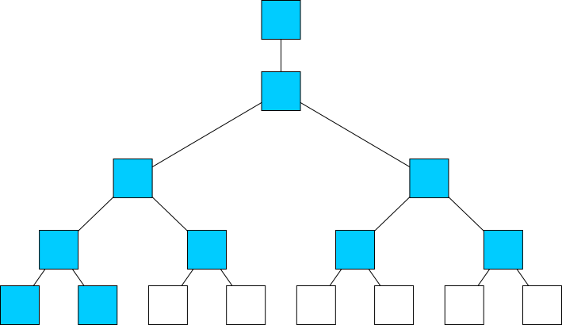
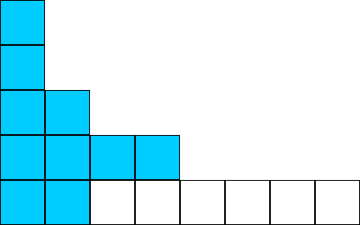
push_back complexity analysis
If we push_back N elements
How many reallocations will happen?
How many moves/copies will happen?
Is it amortized constant complexity?
That means the ratio between number of moves/copies and N is constant.

Slide 10
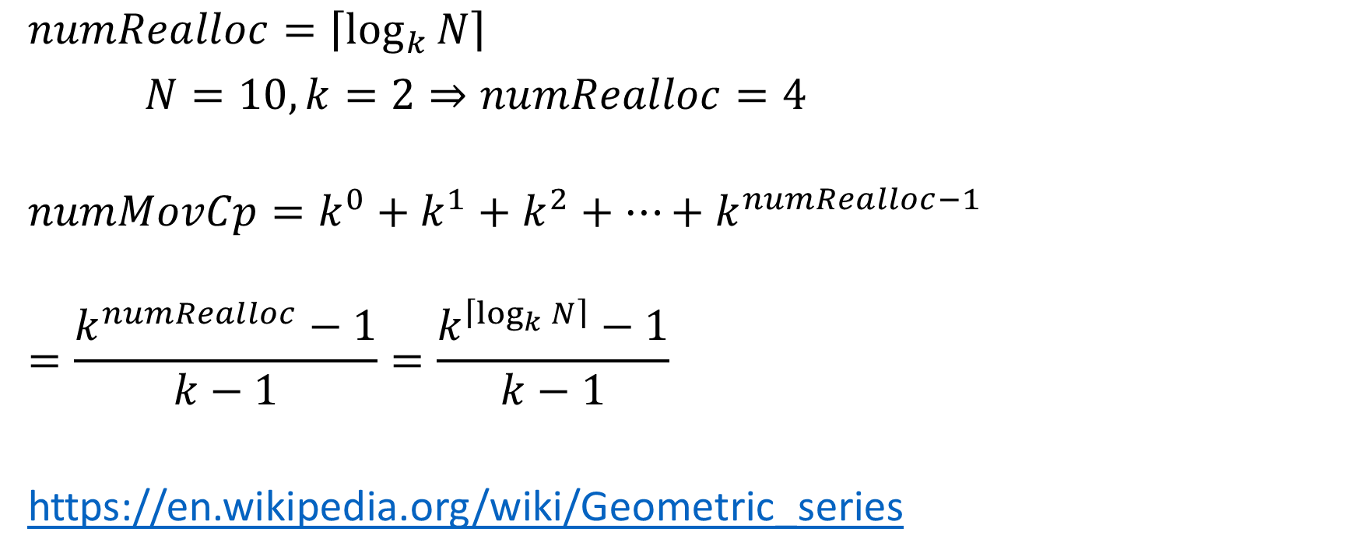
push_back complexity analysis
$$numRealloc=\left\lceil \log_{k}{N}\right\rceil$$
$N=10,k=2⇒numRealloc=4$
$$numMovCp=k^{0}+k^{1}+k^{2}+…+k^{numRealloc−1}$$
$$=\frac{k^{numRealloc}−1}{k−1}=\frac{k^{\left\lceil \log_{k}{N}\right\rceil }−1}{k−1}$$
https://en.wikipedia.org/wiki/Geometric_series

Slide 11
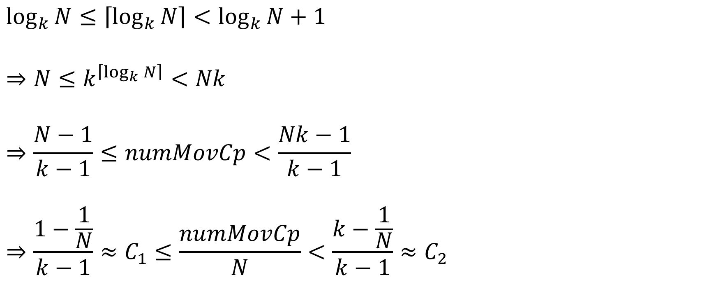
push_back complexity analysis
$$\log_{k}{N}≤\left\lceil \log_{k}{N}\right\rceil <\log_{k}{N}+1$$
$$⇒N≤k^{\left\lceil \log_{k}{N}\right\rceil }<Nk$$
$$⇒\frac{N−1}{k−1}≤numMovCp<\frac{Nk−1}{k−1}$$
$$⇒\frac{1−\frac{1}{N}}{k−1}≈C_{1}≤\frac{numMovCp}{N}<\frac{k−\frac{1}{N}}{k−1}≈C_{2}$$

Slide 12
Reallocation
How can we move/copy old elements?
Move
Efficient.
Not everything can be moved.
Move is not always noexcept.
Copy
Inefficient (imagine we’re copying 1’000 std::string).
Strong exception guarantee.
Move when noexcept, copy otherwise.
If type is uncopyable, and move is not noexcept, still use move.
Dangerous.

Slide 13
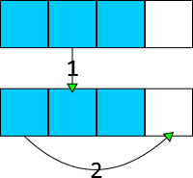
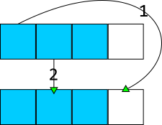
emplace_back
Complexity: Amortized constant.
Exception: Strong.
Implementation
Use perfect forwarding.
emplace_back constructs object inplace.
Can we emplace_back a self element?
vector<int> v{1, 2, 3};
v.emplace_back(v[0]);
Yes.

Slide 14
push_back
Complexity: Amortized constant.
Exception: Strong.
Implementation
Copy or move the input object into vector.
Can be costly.
Can we push_back a self element?
Yes.

Slide 15
reserve
Complexity: Usually O(N)
Exception: Strong
Implementation
Reallocate new memory.
Move/copy old elements.
Used to enlarge “unused” space.

Slide 16
What’s wrong with this?
template <class T> struct my_ptr {
my_ptr(T* p) : m_p{p} {}
~my_ptr() { delete m_p; }
};
vector<my_ptr<int>> v;
v.push_back(new int{0});
v.emplace_back(new int{0});
Don’t use new, unless we have a reason.

Slide 17
What’s wrong with this?
vector<int> v;
for (auto i = 0; i < 1000; ++i)
v.emplace_back(i);
We should do a reserve first.

Slide 18
What’s wrong with this?
vector<int> v{1, 2, 3};
auto x = v.at(0);
vector::at is useless, use vector::operator[] instead.

Slide 19
Recommendation
Design your type so it has noexcept move.
You should use std::vector by default.
"Use vectors whenever you can. If you cannot use vectors, redesign your solution so that you can use vectors." - Alexander Stepanov

Slide 20
Thanks for listening. Question?

